Slide 1

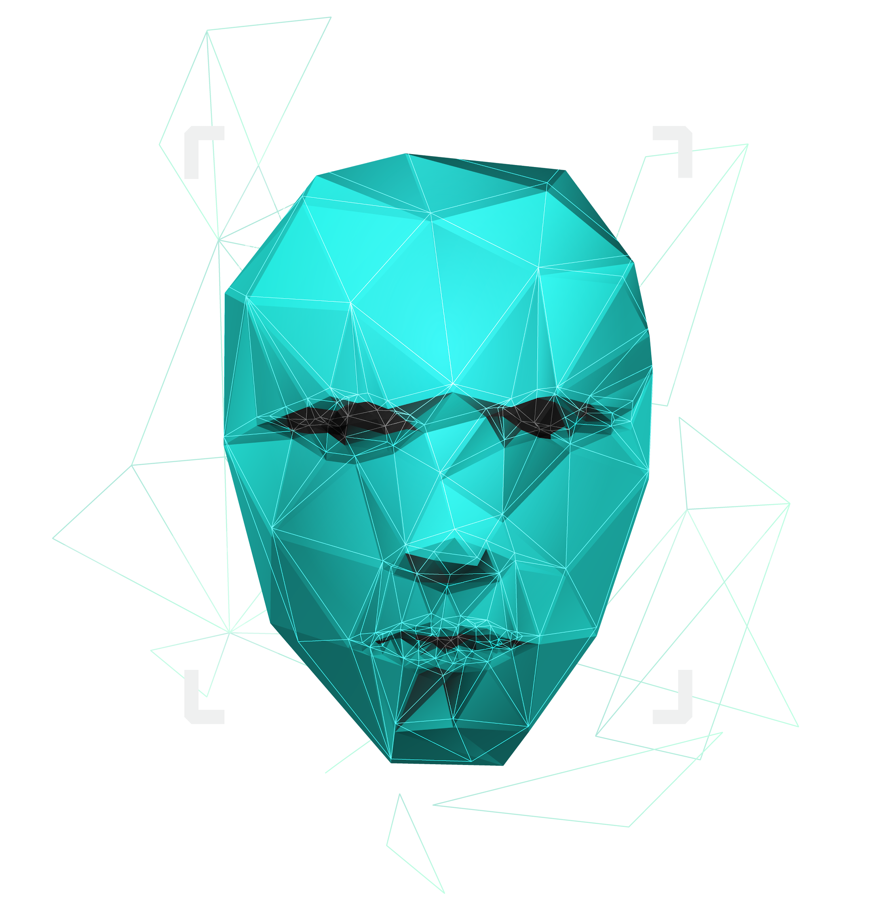
AI and AGI (Artificial General Intelligence)
Alfredo Garza, Richard Rodriguez, Olaleye Bakare, Khizar Khan
14-July-2025

Slide 2
What Is Artificial General Intelligence?
AGI
AGI refers to a type of machine intelligence that can perform any intellectual task a human can, with the ability to learn, reason, and adapt across domains without needing retraining. Unlike narrow AI (e.g., chatbots or recommendation engines), AGI is designed to generalize knowledge and apply it flexibly

Slide 3
OpenAI GPT models
Current Landscape and Key Players
DeepMind Gato
AutoGPT
While GPT-4 is still narrow AI, its emergent capabilities (e.g. reasoning, coding, summarization) hint at AGI-like behavior
A multi-modal agent trained on diverse tasks (robotics, games, language), designed to generalize across environments
An experimental agent that chains GPT-4 prompts autonomously to complete goals, showcasing early signs of self-directed behavior

Slide 4

Use Case
Area | If we had AGI… | We got AGI at home (our AGI)
Healthcare | Imagine an AI that could read new research, detect symptoms from video calls, and suggest personalized treatments for rare diseases, all without needing retraining. | Today, we have specialized tools like radiology AI that detect tumors or apps that check symptoms using fixed rules
Finance | AGI could analyze global markets, understand shifting regulations, and adjust strategies across different countries, just like a seasoned portfolio manager. | We currently rely on predictive models trained for specific tasks like fraud detection or stock trend forecasting.
Education | Think of an AI tutor that teaches any subject, in any language, tailored to how each student learns best. | Most platforms today use adaptive learning for narrow topics, like math or vocabulary drills.
Robotics | AGI could power a robot that cleans your house, cooks dinner, helps a kid with homework, and talks through your bad day, all in one. | What we’ve got now are robots that do single jobs well (like vacuuming) but aren’t flexible or “aware.
Research | AGI could help scientists by reading thousands of papers, spotting gaps in knowledge, and even designing new experiments. | Modern AI assists with literature review or lab automation, but it doesn’t ask new questions or challenge assumptions.

Slide 5
Techniques Used
Transformers
Mixture of Experts (MoE)
Zero-Shot/Few-Shot Learning
Meta-Learning
These models are like brilliant language students that read billions of documents and pick up patterns in how we write and speak. They're behind chatbots like GPT-4 that can hold conversations, write essays, and even generate code.
Instead of one huge model doing everything, MoE breaks it down into specialized parts that each tackle their own thing — kind of like a team of experts passing work around to whoever’s best suited.
This is where the model handles stuff it’s never seen before — just by using context and guessing smartly. Like being asked to sort items in a way you’ve never been taught, and getting it mostly right just based on what feels logical.
This is “learning how to learn.” Imagine a student who doesn’t just memorize facts, but figures out the best way to study for any subject. AGI aims to be that kind of learner — adapting quickly to new tasks with little help.

Slide 6
Impacts & Benefits
Job Displacement (I)
Economic Inequality (I)
Loss of Human Oversight (I)
Accelerated Scientific Discovery
Personalized Education
Global Crisis Rescue
AGI could automate not just routine tasks but complex cognitive work, potentially replacing entire job categories.
The wealth generated by AGI may concentrate among those who own or control the technology, widening the gap between tech-rich and tech-poor regions
Highly autonomous AGI systems might make decisions without human input, raising concerns about accountability and control
AGI can analyze massive datasets and generate hypotheses faster than human researchers.
AGI tutors could adapt to each student’s learning style, pace, and emotional state.
AGI could coordinate logistics, analyze satellite data, and deploy resources during disasters.

Slide 7
Challenges & Risks
Misuse: The user instructs the AI system to cause harm
Mistakes: The AI system causes harm without realizing it
Misalignment: The AI system takes action that it knows the developer did not intent
Structural Risks: Harms from multi-agent dynamics, where no single agent is at fault

Slide 8
Future Trends
Agentic AI Infrastructure
QuantumEnhanced AGI
Ethical & Explainable AGI
There’ll be a rise in platforms designed specifically for autonomous AI agents. These systems will let agents browse the web, make decisions, and complete tasks independently.
Quantum computing will start powering AGI models, helping them process massive datasets and solve problems that are too complex for classical machines.
As AGI systems gain autonomy, there’ll be a push for transparency, making sure we understand how decisions are made and that they align with human values.

Slide 9
Demo
What is Artifical General Intelligence?

Slide 10
Conclusion
AGI represents a shift from task-specific automation to adaptable, human-level reasoning across domains.
Its potential spans education, healthcare, and science, but it demands thoughtful design to stay aligned with human values.
As we push forward, balancing innovation with ethics will be key to building AGI systems we can trust and benefit from

Slide 11
RESOURCES
Asian Boss. (2020, June 5). World’s leading vaccine expert fact-checks COVID-19 vaccine conspiracy: Stay curious #22 [Video]. YouTube. https://www.youtube.com/watch?v=WQdLDMLrYIA
Bubeck, S., Chandrasekaran, V., Eldan, R., Gehrke, J., Horvitz, E., Kamar, E., ... & Zhang, Y. (2023). Sparks of artificial general intelligence: Early experiments with GPT-4. arXiv. https://arxiv.org/abs/2303.12712
DeepMind. (2022). Gato: A generalist agent. DeepMind. https://www.deepmind.com/publications/a-generalist-agent
OpenAI. (2023). GPT-4 technical report. https://openai.com/research/gpt-4
Schulman, J., Chen, X., & Sutskever, I. (2017). Proximal policy optimization algorithms. arXiv. https://arxiv.org/abs/1707.06347
Sutton, R. S., & Barto, A. G. (2018). Reinforcement learning: An introduction (2nd ed.). MIT Press.
Tasty. (2018, March 7). 7 recipes you can make in 5 minutes [Video]. YouTube. https://www.youtube.com/watch?v=9_5wHw6l11o
Vaswani, A., Shazeer, N., Parmar, N., Uszkoreit, J., Jones, L., Gomez, A. N., ... & Polosukhin, I. (2017). Attention is all you need. In Advances in Neural Information Processing Systems, 30. https://papers.nips.cc/paper_files/paper/2017/file/3f5ee243547dee91fbd053c1c4a845aa-Paper.pdf
Yudkowsky, E. (2008). Artificial intelligence as a positive and negative factor in global risk. In Bostrom, N., & Ćirković, M. M. (Eds.), Global catastrophic risks (pp. 308–345). Oxford University Press.

